Slide 1
Superstore Sales Dashboard
Prepared By Avinash Padghan
Data Analyst Intern at TechnoSignia

Slide 2

Project Overview
✔ Analyze Sales
✔ Clean Data
✔ Perform EDA
✔ Build Dashboard
✔ Business Insights

Slide 3
Dataset Information
Dataset Source
Kaggle Dataset
Name Sample Superstore
Rows 10210 Columns 21

Slide 4

Data Cleaning
Missing Values
↓
Duplicates
↓
Data
↓
Types
↓
Ready Dataset

Slide 5
EDA (Exploratory Data Analysis)
✔ Sales Analysis
✔ Profit Analysis
✔ Region Analysis
✔ Category Analysis
✔ Monthly Trend

Slide 6
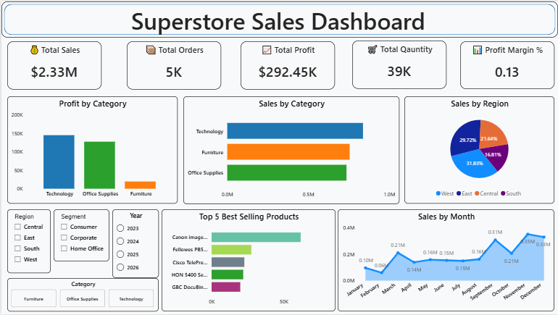
Power BI Dashboard

Slide 7

Business Insights
Technology has highest Sales
West Region performs best
Sales peak in October-November
Top Products generate high revenue
Furniture profit is lower

Slide 8
Technology Used
Python
↓
Pandas
↓
NumPy
↓
Matplotlib
↓
Power BI

Slide 9
Recommendations
Increase Technology inventory
Reduce unnecessary discounts
Improve low-performing regions
Promote Top Products
Use Dashboard for decisions

Slide 10
Conclusion
This project helped me understand the complete data analysis workflow, starting from data cleaning to dashboard creation.
Using Python and Power BI, I analyzed the sales data, identified business trends, and created an interactive dashboard.
The dashboard provides useful insights that can help businesses make better decisions based on sales and profit performance.

Slide 11
Thank You !!

